Slide 1
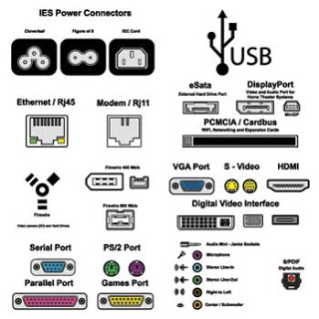
CSE360-Computer Interfacing BRAC University
Computer Ports

Slide 2
Computer Ports
Computer ports are connection points or interfaces with other peripheral devices.
There are two main type of computer ports:
Parallel Ports Serial Ports
Others types are also there
PS2, SCSI etc.

Slide 3
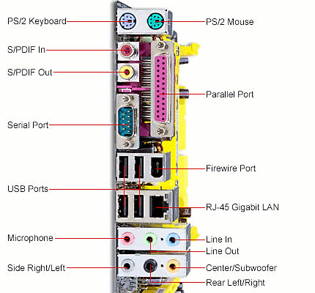
Computer Ports

Slide 4
Parallel Port
Parallel port is used for data transfer between a computer and a peripheral device through a 25 or 36 pin connector.
In parallel communication multiple bits are transferred at a time.
By using the IEEE 1284 standard the parallel port becomes a bidirectional data gateway (can be used for transferring and receiving data packages).
The parallel port speed can range from 50 KBPS to 150 KBPS and can go up to 2 MBPS.
The 2 MBPS speed is achieved when the EPP and ECP modes are used as a 32 or 16 bit transfer interface who uses a 8 bit IN / OUT hardware.

Slide 5
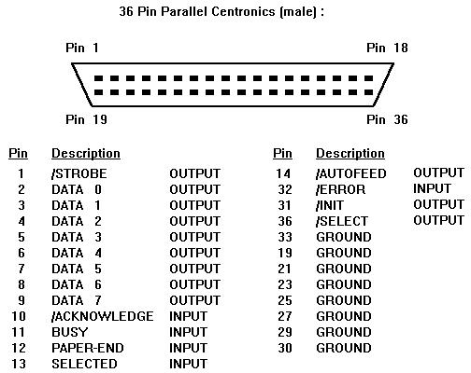
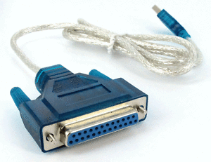
Parallel Port

Slide 6
Serial Port
Serial port is a electronic communication gateway used for transferring data one bit at a time.
Together with parallel port the serial port was used almost for all type of information transfer between a computer and other peripheral devices.
Today the serial port has been replaced with dedicated ports like USB port, vga port, Ethernet port or internet port (used for network communication; any type of information).

Slide 7
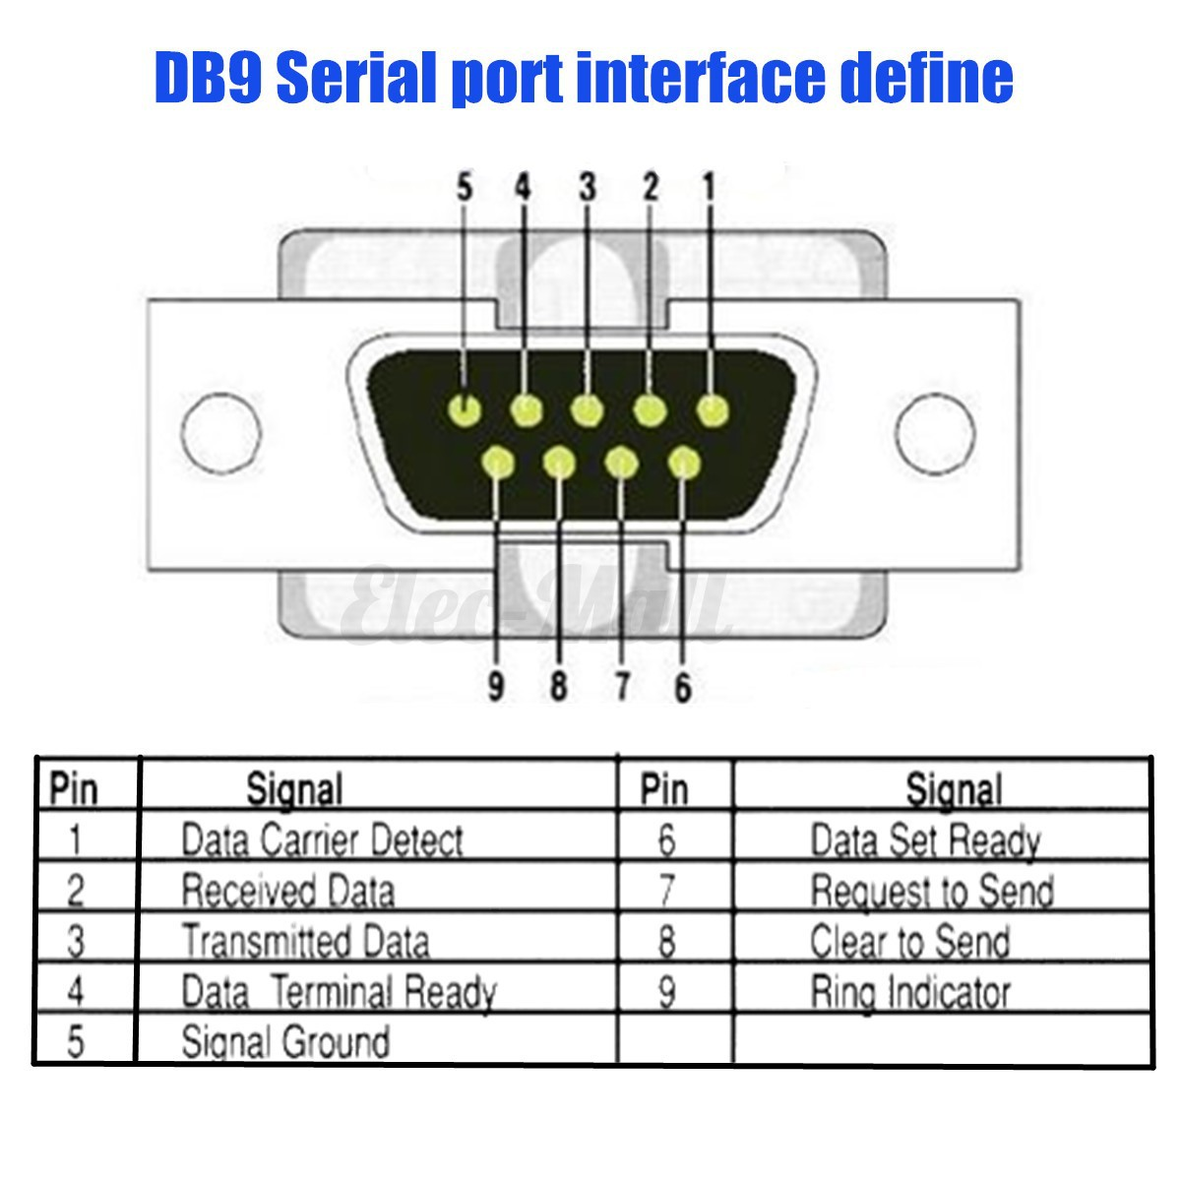
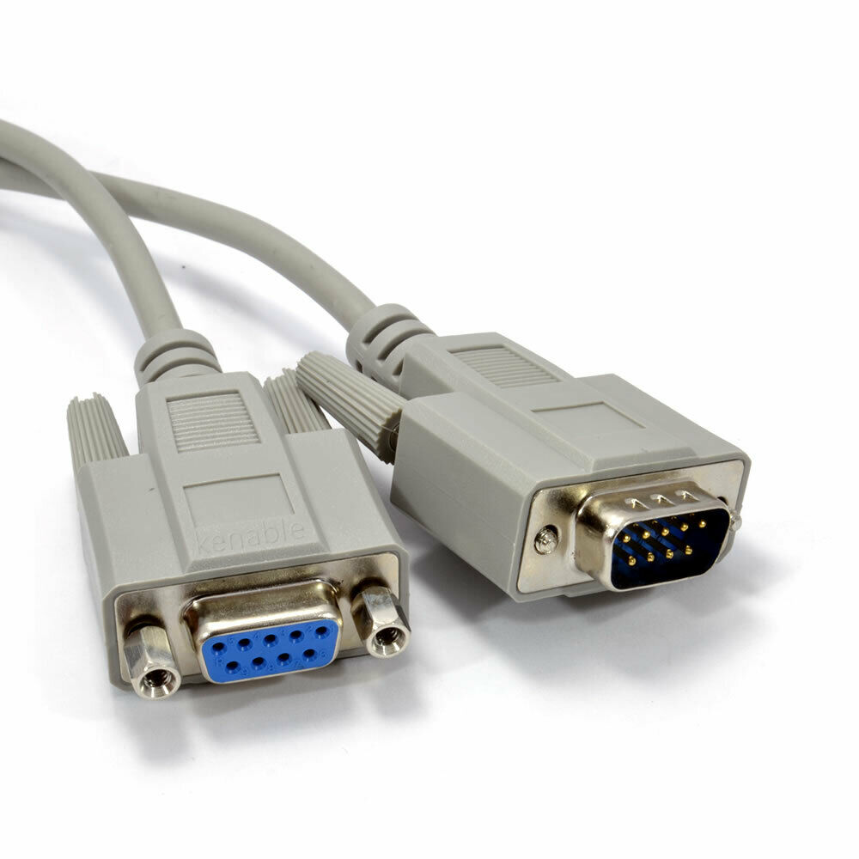
Serial Port

Slide 8
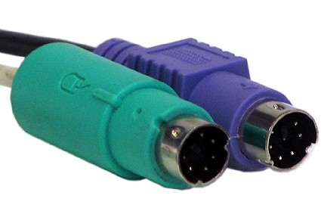
PS2 Port
The PS2 port is used for connecting keyboards and mice to a PC.
The main purpose of PS2 was replacing the serial keyboard and mouse.
In our days PS2 port was replaced by USB port, which is more easy to implement on a PC even though PS2 offers more capability and a greater speed.
PS2 connector color code Purple – Keyboard Green – Mouse

Slide 9
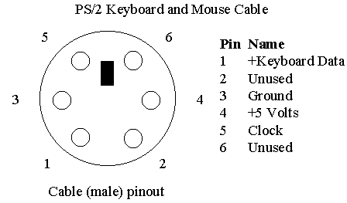
PS2 Port

Slide 10
USB
USB port ( Universal Serial Bus ) is the most used connection point for data transfer in the world.
It is designed for devices like printers, mice and to some extent for all.
• USB hub - 127 devices to a USB port. – Speed share
• Draw power
• USB 2.0 -480 Mbps.
• USB 3.0-5 Gbps (bi-directional)
• 4 pins
• No clock
One Standard Connector
Easier to configure
Faster transfer rates
Can provide power

Slide 11
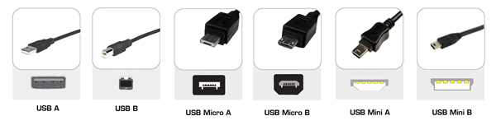
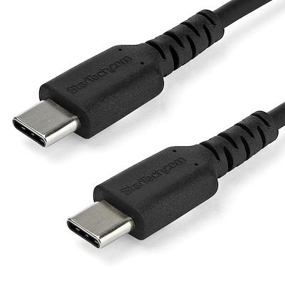
Types of USB
First- USB 1.0 - 1.5 Mbit/s
Latest - USB 4.0 - 40 Gbit/s
Type B:
Printer
External Hard Drive
microphone
Type Mini B:
Older phones
Digital Cameras
Type Micro B (Slimmer than Mini B)
Modern Slimmer devices
Type A: Host Connector
Mainly for computer
Type C:
thin
no up and down orientation
slimmer moden devices
both end work as host

Slide 12
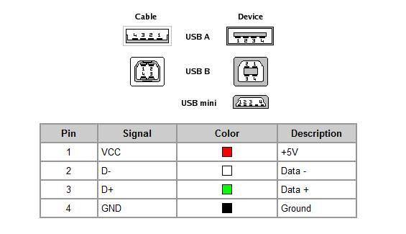
USB Port Pinout

Slide 13
Firewire Port
IEEE 1394 port
Connect multiple types of devices that require faster data transmission speeds.
The three latest version (FireWire 800, FireWire 1600 and FireWire 3200 ) have speeds faster than the original FireWire 400.
Use FireWire hub to attach multiple devices to a single FireWire port.
Supports Plug and Play.
Firewire IEEE 1394 port supports the following operating systems: Mac OS 8.6, 9, Mac OS X, Microsoft Windows, Haiku, Linux, FreeBSD and NetBSD.
Firewire can handle more data than USB
-Display devices, Home theatre devices plugged in Mac, Video cameras

Slide 14
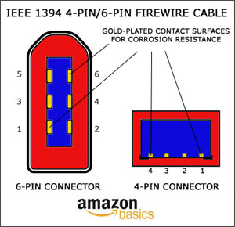
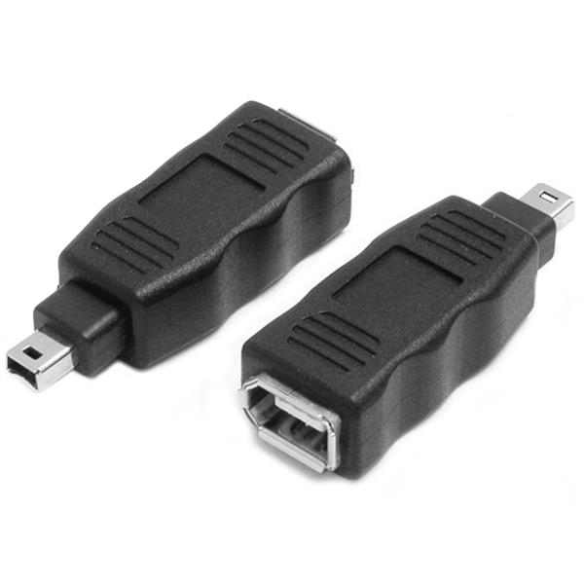
Firewire Port

Slide 15
Ethernet Port
Ethernet port is a network hardware interface used for data transfer and control between at least two devices that can support the ip protocol.
Coaxial and twisted pair cable was used as Ethernet Ports.
Twisted pair cable is used only on short distances, like the connection between a computer modem port or network port and a Ethernet switch or router.
On long distances fiber optic links are used as Ethernet cable.
Speed can vary 10Mbps up to 10Gbps. High speeds are usually used in large data transfer networks like a CCTV IP network or cable company but in the last case high speed is only obtained between switches or routers in most cases the client receives only 10 or 100 Mbps.

Slide 16
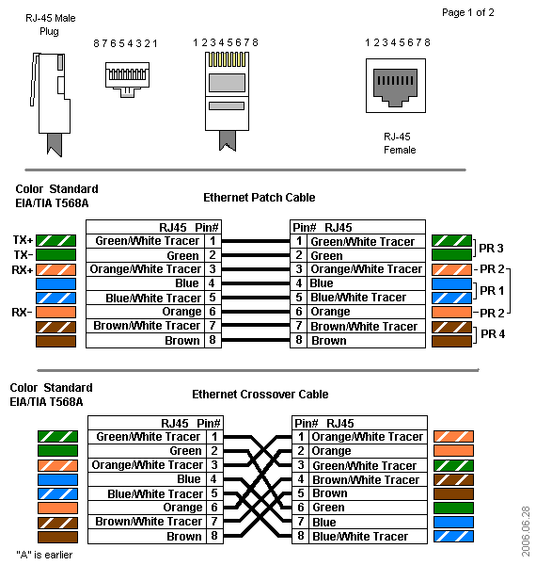
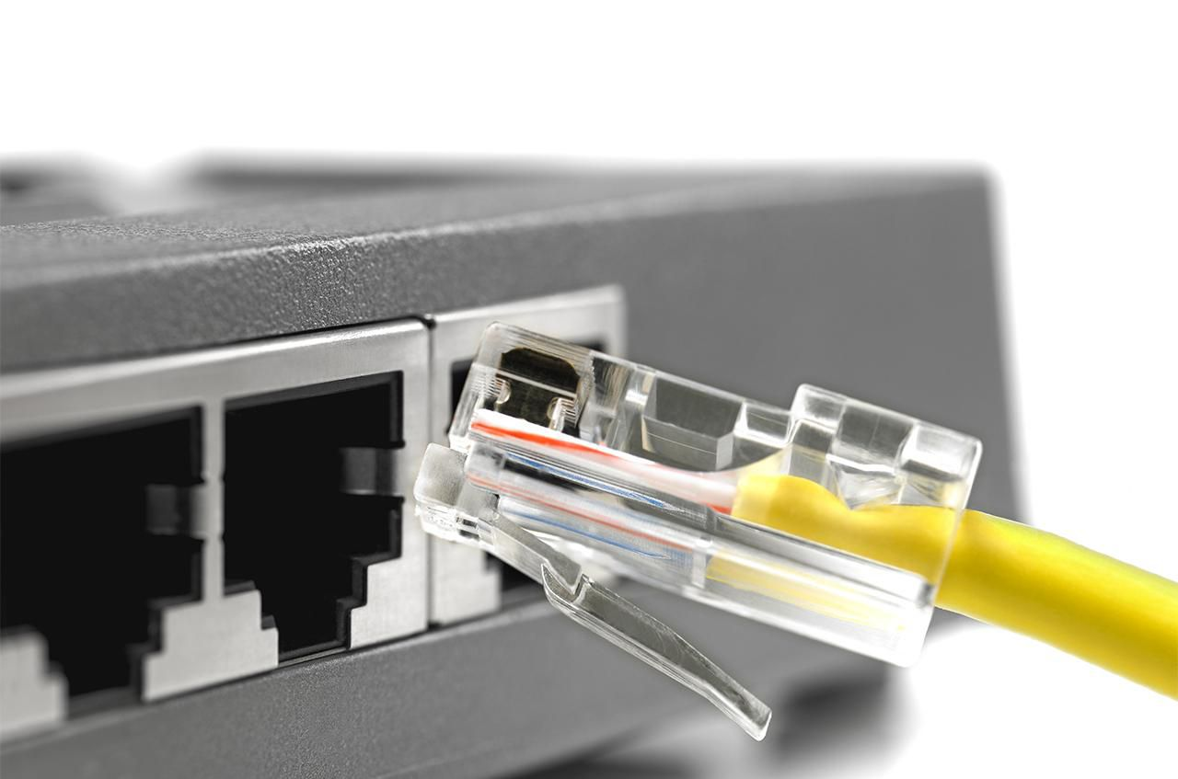
Ethernet Port

Slide 17
Ethernet Port
The maximum Ethernet cable length between switches computers and routers is 100 meters or 328ft. After this the signal starts losing in amplitude and you could experience connection loss. If you want to use internet cables on longer distances it is better to use signal boosters for every 100 meters. A more efficient way is to use fiber optic cable who with special equipment can go up to 20 km without any signal booster.
Router, Modem, Internet Entryway or telephone line

Slide 18
.
Thank You For Your Attention

